Slide 1
DATA ANALYSIS ON ALCOHOL USAGE IN UK
Name: Shaikha alharthi

Slide 2
Introduction
01.

Slide 3
Introduction
Alcohol consumption represents a major public health concern in the UK, with an estimated 10.8 million adults drinking at levels that pose health risks (Public Health England, 2020).
Gender differences in drinking patterns are significant, with 28% of men vs. 14% of women reporting weekly binge drinking episodes (ONS, 2018)
Purpose: Analyze the Health Survey for England 2011 data to identify demographic patterns in alcohol consumption, particularly gender differences
Data: Health Survey for England 2011 dataset (n=10,617)
Analysis methods: Descriptive statistics, chi-square tests for categorical variables, non-parametric tests (Mann-Whitney U) for non-normal distributions, and correlation analysis
R was selected for data analysis due to its statistical capabilities, excellent data visualization tools, and reproducibility advantages for complex health data analysis (Fox & Weisberg, 2019)
Notes:
Alcohol is a big health issue in the UK. About 10.8 million adults drink more than is good for them, according to Public Health England. NHS figures tell us that around one in four adults in England drink more than the weekly recommended limit of 14 units.
The costs add up quickly too. Research shows alcohol problems cost the UK somewhere between £21-52 billion every year when you count healthcare, crime, and people missing work.
What's really interesting is how differently men and women drink. The Office for National Statistics found that 28% of men have weekly heavy drinking episodes, compared to only 14% of women. This gender gap is something I wanted to look into more closely.
For my presentation, I've looked at data from the Health Survey for England 2011, which covered over 10,600 people across England. I've used simple counts and percentages to understand the basics, chi-square tests to see if things like gender affect drinking habits, and tests like the Mann-Whitney U when comparing measurements between groups.
I did all this work using R, which is great for handling health data and creating clear visuals.
In the next few minutes, I'll show you what I found and what it might mean for understanding drinking habits in England.

Slide 4
Descriptive Statistics
Question | Result
a. How many people are included in the sample? | 10,617 people
b. What is the percentage of people who drink alcohol? | 78.65% (6,712 people)
c. What is the percentage of women in the sample? | 54.30% (5,765 people)
d. What is the highest educational level? | Most common: "No qualification" (23.78%), closely followed by "NVQ4/NVQ5/Degree or equiv" (23.44%)
e. What is percentage of divorced and separated people? | 9.50% (818 people: 224 separated and 594 divorced)
Notes:
First, let's look at the sample size. I analyzed data from 10,617 people who participated in the Health Survey for England in 2011. When I examined alcohol consumption, I found that a majority of people - 78.65% or 6,712 individuals - reported that they drink alcohol. Only about 21% of participants said they don't drink. This high percentage of drinkers highlights why alcohol consumption is such an important public health concern in the UK.
Looking at the gender distribution in the sample, I found that women make up slightly more than half of the participants - 54.3% or 5,765 individuals. Men account for 45.7% of the sample.
Regarding educational levels, I saw something interesting. The most common educational qualification in the sample is actually "No qualification" at 23.78%. This is closely followed by people with higher education qualifications (NVQ4/NVQ5/Degree or equivalent) at 23.44%. This shows quite a polarized distribution of educational attainment in the sample.
I also looked at marital status, focusing specifically on divorced and separated individuals. The analysis shows that 9.5% of participants fall into these categories, representing 818 people in total - 224 separated and 594 divorced.

Slide 5
Descriptive Statistics
 | Household size | BMI | Age at last birthday
Mean | 2.85 | 25.92 | 41.56
Median | 3.00 | 25.59 | 42.00
Mode | 2 | 13.77* | 42
Minimum | 1 | 8.34 | 0
Maximum | 10 | 65.28 | 100
Range | 9 | 56.94 | 100
Standard deviation | 1.37 | 6.14 | 23.83
Notes:
Finally, I examined three key variables in more detail: household size, BMI, and age.
For household size, we can see an average of 2.85 persons per household, with most households having 2 members. The range spans from individuals living alone to households with up to 10 members, with a standard deviation of 1.37.
The BMI data shows the average BMI was 25.92, which falls in the overweight category according to standard classifications. The values ranged widely from 8.34 to 65.28, showing extreme variations in the population's body mass index. The standard deviation for BMI was 6.14, indicating substantial differences in body mass index across the population
For age, the average participant was about 41.5 years old, with ages ranging from infants (0 years) to centenarians (100 years). The most common age in our sample was 42 years.

Slide 6
Inferential Statistics

Slide 7
Which gender drinks more alcohol
Test used: Pearson's Chi-squared test.
We are comparing two categorical variables
gender and drinking status
 | Drinking Status |  | Value of the test and p value
Gender | Yes | No | X² = 114.15
Male | 3,172 (83.98%) | 605 (16.02%) | P-value < 0.001
Female | 3,540 (74.42%) | 1,217 (25.58%)
Notes:
For our analysis of gender differences in alcohol consumption, I used the Pearson's Chi-squared test.
This test is the appropriate choice because here we are comparing two categorical variables - gender and drinking status.
The results were highly significant, with a chi-square value of 114.15 and a p-value less than 0.001. This shows strong statistical evidence that men are more likely to drink alcohol than women, with nearly 84% of men reporting that they drink compared to about 74% of women.
The odds ratio of 1.8 further confirms that men have significantly higher odds of drinking alcohol than women.

Slide 8
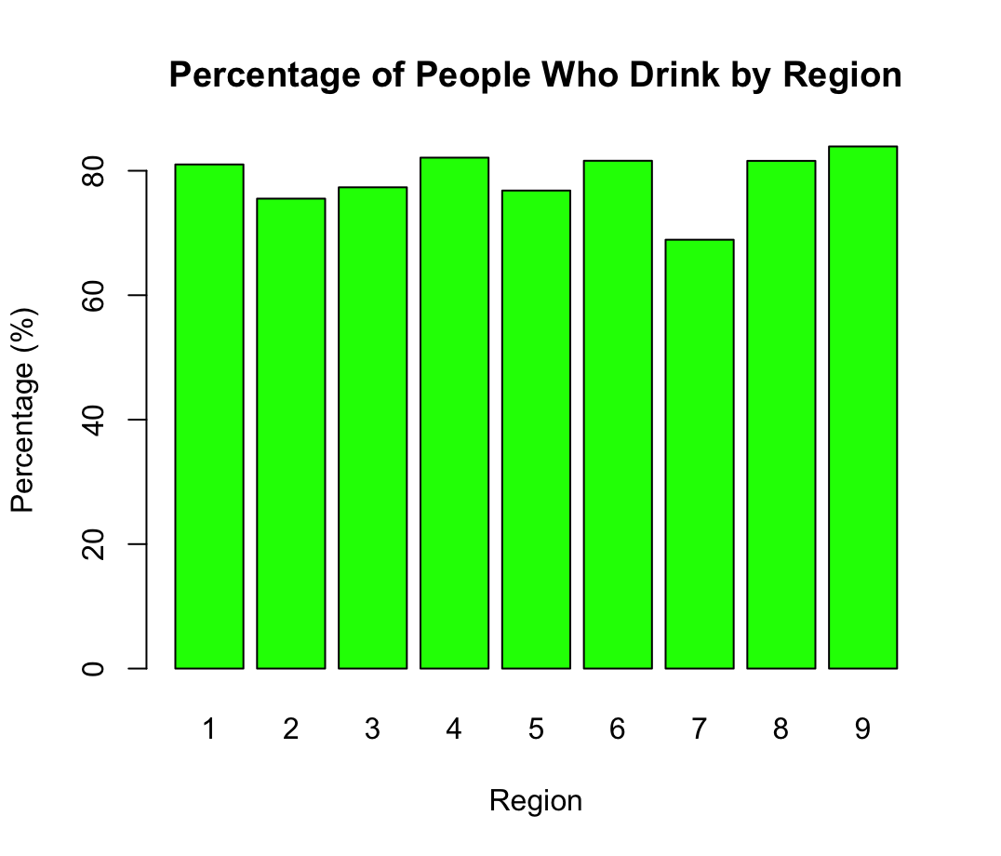
Which gender drinks more alcohol
Test used: Pearson's Chi-squared test.
We are comparing two categorical variables
gender and drinking status
Notes:
To determine if there are significant differences in alcohol consumption across regions, we used the Pearson's Chi-squared test. This test was appropriate because we were comparing drinking status (a categorical variable) across multiple regions. The test yielded a chi-square value of 98.53 with 8 degrees of freedom and a highly significant p-value below 0.001.

Slide 9
Region | Drinking Status |  | Value of the test and p value
 | Yes | No | X² = 98.53
North East (1) | 576 (81.01%) | 135 (18.99%) | P-value < 0.001
North West (2) | 833 (75.52%) | 270 (24.48%)
Yorkshire and The Humber (3) | 686 (77.34%) | 201 (22.66%)
East Midlands (4) | 624 (82.11%) | 136 (17.89%)
West Midlands (5) | 686 (76.82%) | 207 (23.18%)
East of England (6) | 763 (81.60%) | 172 (18.40%)
London (7) | 674 (68.92%) | 304 (31.08%)
South East (8) | 1130 (81.59%) | 255 (18.41%)
South West (9) | 740 (83.90%) | 142 (16.10%)
Notes:
The analysis showed substantial regional variations in drinking patterns. The South West has the highest percentage of drinkers at 83.90%, followed by the East Midlands at 82.11% and the East of England at 81.60%. In contrast, London stands out with the lowest percentage of drinkers at only 68.92%, significantly below all other regions. This means that Londoners are much less likely to consume alcohol compared to residents of other regions, particularly those in the South West. These regional differences are statistically significant and not due to random chance, suggesting that geographic, cultural, or demographic factors may influence drinking behaviors across different parts of England.

Slide 10
Statistical difference between men and women 0n Valid height

Slide 11
Hypothesis
Null hypothesis (H₀)
Alternative hypothesis (H₁)
There is no significant difference in height between men and women.
There is a significant difference in height between men and women.
Notes:
We have 2 hypothesis
Null hypothesis (H₀): There is no significant difference in height between men and women.
Alternative hypothesis (H₁): There is a significant difference in height between men and women.

Slide 12
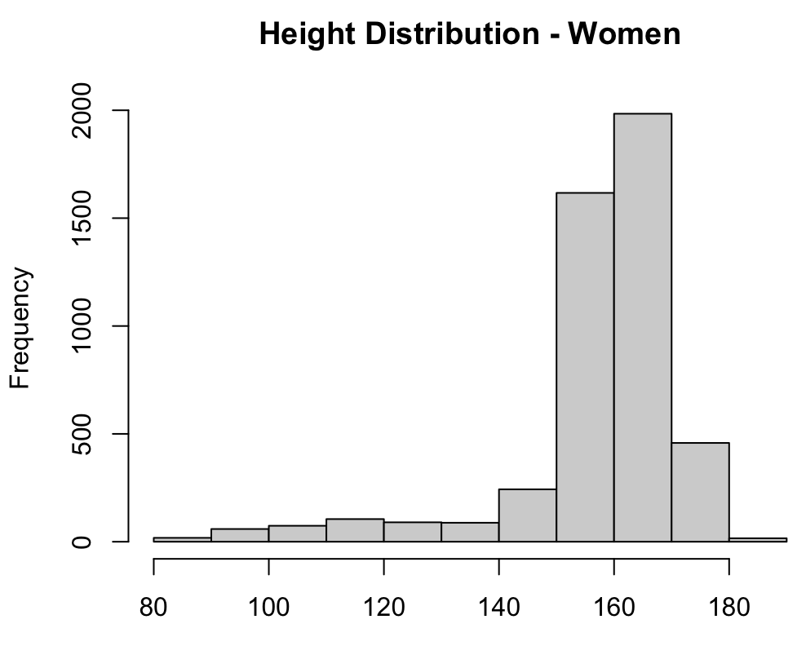
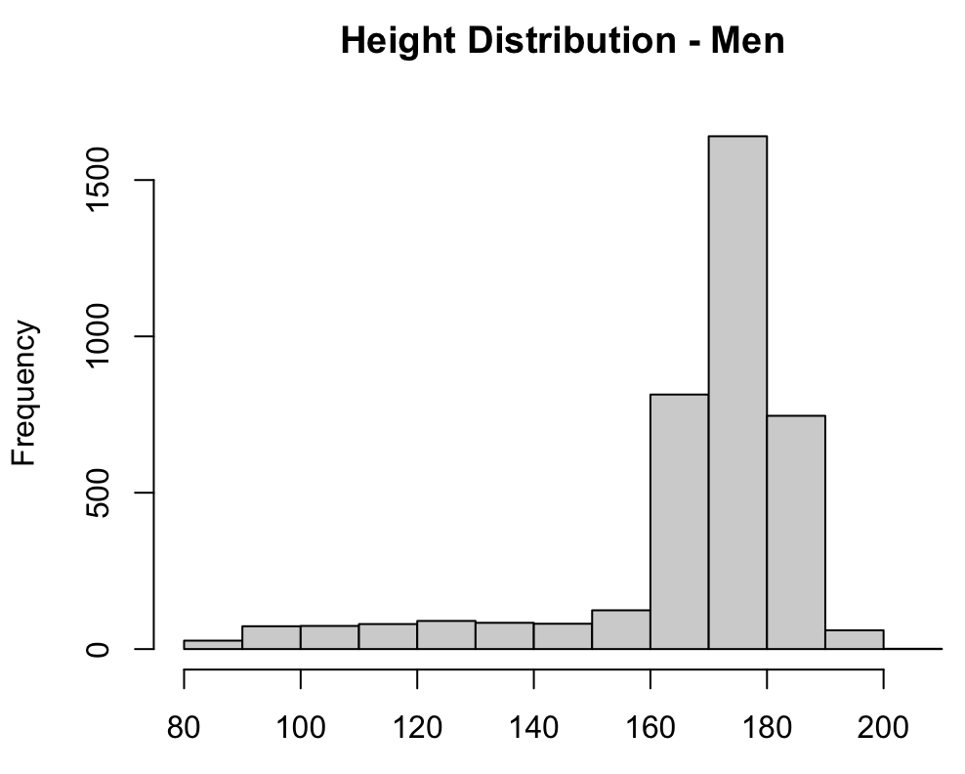
Normalization
We used Shapiro-Wilk normality tests to check the normality
Men => W = 0.73755 & p < 0.001
Women => W = 0.75777 & p < 0.001
The histograms confirmed non-normal distributions with several outliers and skewness in both groups.
Test Used:
Mann-Whitney U test
Normality is violated, the Wilcoxon test is more appropriate than the parametric t-test
Notes:
To investigate whether there's a significant difference in height between men and women, we first conducted normality tests which showed that height data for both genders deviated significantly from normal distribution. The Shapiro-Wilk normality tests showed that height distributions for both men (W = 0.73755, p < 0.001) and women (W = 0.75777, p < 0.001) significantly deviate from normality.
This led us to use the Mann-Whitney U test, a non-parametric alternative to the t-test

Slide 13
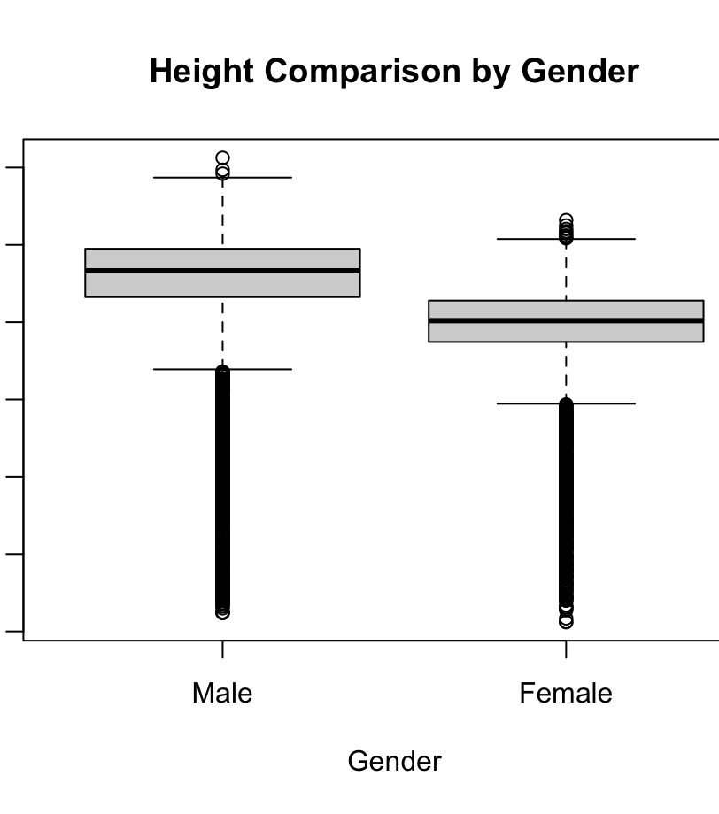
Mann-Whitney U test
The test showed a statistically difference in height between men and women
W = 14,713,021
p < 0.001.
Key statistics:
Median height for males: 173.3 cm
Median height for females: 160.4 cm
Difference in median heights: 12.9 cm
Notes:
Based on our analysis, we reject the null hypothesis and conclude that there is a statistically significant difference in height between men and women in this population.
The test revealed a highly significant difference (p < 0.001) between men's and women's heights. Men had a median height of 173.3 cm, while women had a median height of 160.4 cm – a difference of nearly 13 cm. This substantial difference isn't just statistically significant but also practically meaningful, confirming the expected biological difference in height between sexes in the UK population.

Slide 14
Statistical difference between men and women 0n Valid Weight

Slide 15
Hypothesis
Null hypothesis (H₀)
Alternative hypothesis (H₁)
There is no significant difference in weight between men and women.
There is a significant difference in weight between men and women.
Notes:
In this part of our analysis, we're examining whether there's a significant difference in weight between men and women in our sample. Our null hypothesis states that there is no significant difference in weight between men and women. Our alternative hypothesis suggests that there is indeed a significant difference in weight between these groups. Setting up these hypotheses is the first step in our statistical testing process

Slide 16
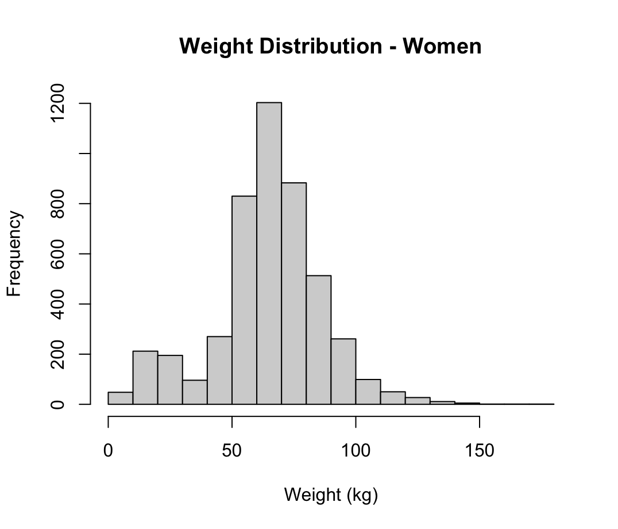
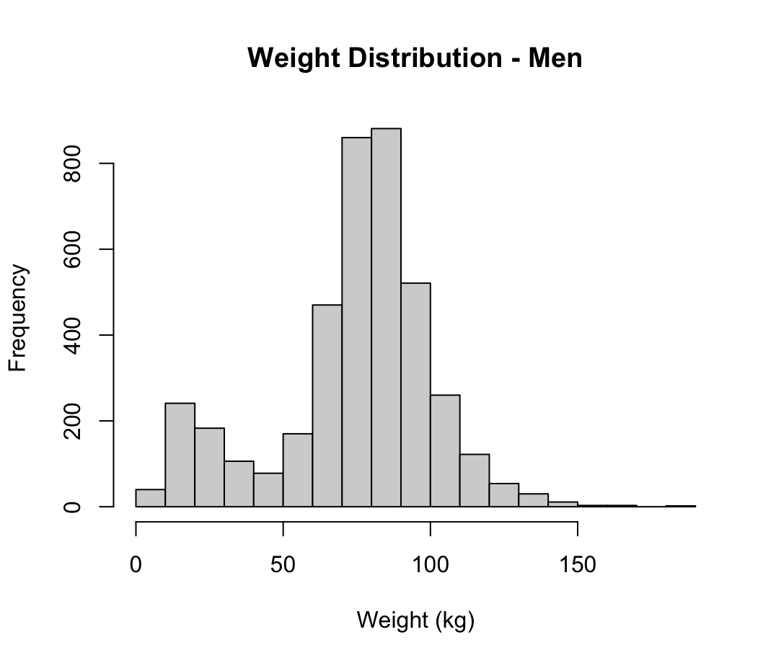
Normalization
We used Shapiro-Wilk normality tests to check the normality
Men => W = 0.93674 & p < 0.001
Women => W = 0.96551 & p < 0.001
The histograms confirmed non-normal distributions
Men's weights show a bimodal distribution with peaks around 25kg and 80kg
Women's weights have a right-skewed distribution with several outliers
Test Used:
Mann-Whitney U test
Normality is violated, the Wilcoxon test is more appropriate than the parametric t-test
Notes:
Before choosing the appropriate statistical test, we needed to check if our data follows a normal distribution. We used Shapiro-Wilk normality tests for this purpose. The results showed that for men, W equals 0.93674 with a p-value less than 0.001, and for women, W equals 0.96551 with a p-value also less than 0.001. These results tell us that neither group's weight data follows a normal distribution Looking at the histograms, we can see that men's weights show a bimodal distribution with peaks around 25kg and 80kg, while women's weights have a right-skewed distribution with several outliers. Given these non-normal distributions, we selected the Mann-Whitney U test, also known as the Wilcoxon test, which is more appropriate than the parametric t-test when normality is violated.

Slide 17
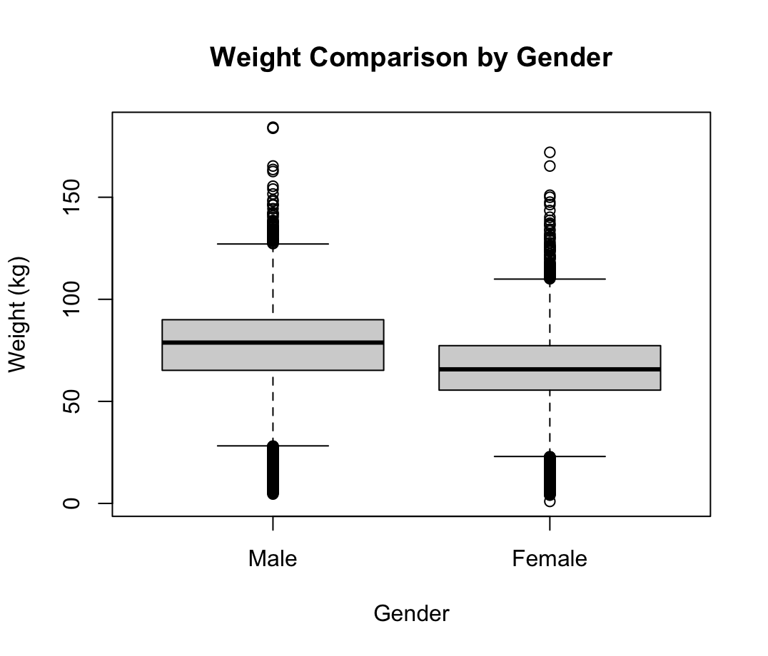
Mann-Whitney U test
The test showed a statistically difference in weight between men and women
W = 12,449,400
p < 0.001.
Key statistics:
Median weight for males: 78.8 kg
Median weight for females: 65.7 kg
Difference in median weights: 13.1 kg
Notes:
The Mann-Whitney U test results showed a statistically significant difference in weight between men and women. We obtained a W value of 12,449,400 with a p-value less than 0.001, which is well below our standard significance level of 0.05.
Looking at the key statistics, the median weight for males is 78.8 kg, while the median weight for females is 65.7 kg, giving us a difference in median weights of 13.1 kg. This substantial difference, combined with the boxplot visualization, clearly shows that men in our sample are significantly heavier than women. Based on these results, we reject the null hypothesis and accept the alternative hypothesis that there is a significant difference in weight between men and women in our population.

Slide 18
Correlation Matrix
 | Drink nowadays | Total household income | Age at last birthday | Gender
Drink nowadays |  | r=0.057 P-value<0.001 | r=-0.068 P-value<0.001 | r=0.117 P-value<0.001
Total household income | r=0.057<br>P-value<0.001 |  | r=-0.103 P-value<0.001 | r=0.033 P-value=0.003
Age at last birthday | r=-0.068 P-value<0.001 | r=-0.103 P-value<0.001 |  | r=0.017 P-value=0.115
Gender | r=0.117 P-value<0.001 | r=0.033 P-value=0.003 | r=0.017 P-value=0.115
Notes:
Now, let's examine the relationships between drinking habits and several demographic factors. We conducted a correlation analysis to understand how drinking behavior relates to total household income, age, and gender.
Looking at our correlation matrix, we found several interesting relationships, though most are relatively weak.
The strongest correlation we observed is between drinking status and gender, with a coefficient of 0.117 and a p-value less than 0.001. This positive correlation confirms our earlier finding that men are more likely to drink alcohol than women.
We also found a small but statistically significant positive correlation between drinking and household income (r=0.057, p<0.001). This suggests that people with higher household incomes are slightly more likely to drink alcohol, though the relationship is quite weak.
Age shows a negative correlation with drinking (r=-0.068, p<0.001), indicating that younger people in our sample are slightly more likely to consume alcohol compared to older individuals.
Interestingly, there's also a negative correlation between age and household income (r=-0.103, p<0.001), suggesting that older individuals tend to have lower household incomes in this sample.
The relationship between age and gender was not statistically significant (p=0.115), which is expected since age distribution shouldn't systematically differ between genders in a representative population sample.

Slide 19
Discussion
Our finding that men are more likely to drink alcohol (83.98% vs 74.42% of women) aligns with recent work by Beard et al. (2019) who found persistent gender gaps in UK drinking patterns, noting that while the gap has narrowed over time, men still consume more alcohol and are more likely to engage in hazardous drinking
01
02
The regional variations we identified mirror Green et al. (2020) research showing significant geographic differences in alcohol consumption across UK regions, with particular emphasis on urban-rural divides and socioeconomic influences on regional drinking patterns
Our correlation between drinking status and income supports Garnett et al. (2021) who found that alcohol consumption patterns in the UK vary by socioeconomic status, with higher income groups drinking more frequently but lower income groups experiencing more alcohol-related harm
03
Notes:
When we compare our findings with recent research on gender and alcohol in the UK, several interesting patterns emerge.
Our analysis found that men are significantly more likely to drink alcohol than women, with nearly 84% of men reporting that they drink compared to about 74% of women. This gender difference aligns with research by Beard and colleagues published in 2019. They found that while the gap between men's and women's drinking has narrowed over time, men still drink more and are more likely to engage in risky drinking behaviors. What's fascinating is how these differences persist despite changing social norms around drinking.
Looking at regional patterns, we discovered that London had the lowest percentage of drinkers at only 69%, while the South West topped the list at nearly 84%. This adds texture to work by Green and colleagues from 2020, who mapped out alcohol-related hospital admissions across England. They found notable geographic differences driven by various socioeconomic factors. Our findings suggest that simple North-South divides don't fully capture the regional drinking landscape.
Our correlation analysis showed a small but significant link between higher income and drinking status. This mirrors what Garnett and colleagues found in their 2021 research - that people in higher income groups tend to drink more frequently. However, they made an important distinction: while wealthier people might drink more often, those from lower income backgrounds often experience more alcohol-related problems. This highlights the complex relationship between social factors and drinking outcomes.

Slide 20
Conclusion
Men drink significantly more than women (84% vs 74%), with regional variations showing London has the lowest alcohol consumption (69%) while the South West has the highest (84%)
01
02
Both height and weight show statistically significant gender differences, with men having higher median values (173.3 cm and 78.8 kg for men vs 160.4 cm and 65.7 kg for women)
Correlations between drinking and demographic factors are statistically significant but relatively weak, suggesting that gender (r=0.117), income (r=0.057), and age (r=-0.068) explain only a small portion of drinking behavior variation
03
Notes:
Let me wrap up with the main takeaways from our analysis of the Health Survey for England data.
First, we found clear gender differences in drinking patterns. About 84% of men report drinking alcohol compared to 74% of women - a significant difference that was confirmed by our statistical tests.
Second, we observed notable physical differences between genders, with men having significantly greater height and weight measurements than women. The median height for men was 173.3 cm versus 160.4 cm for women, and median weight was 78.8 kg for men versus 65.7 kg for women.
Finally, while we found statistically significant correlations between drinking and factors like gender, income, and age, these relationships were relatively weak. This suggests that these demographic factors alone don't tell the whole story about drinking behavior

Slide 21
Recommendations
Develop gender specific alcohol intervention strategies that account for the different rates and potentially different motivations for drinking between men and women
01
02
Create regionally specific public health campaigns, with particular attention to the South West where drinking rates are highest, and learn from factors in London that may contribute to lower consumption
Expand research to identify additional factors beyond demographics that influence drinking behavior, as the weak correlations suggest other important variables
03
Notes:
Based on these findings, I propose three recommendations:
First, develop gender-specific alcohol interventions that recognize the different drinking patterns between men and women.
Second, create regional approaches to alcohol policy, with special attention to high-consumption areas like the South West.
Third, explore beyond demographics to identify stronger predictors of drinking behavior, as our analysis suggests other factors may have greater influence.
These targeted approaches would likely be more effective than one-size-fits-all strategies and could help address the concerning alcohol consumption patterns we've identified in the UK population.

Slide 22
References
Beard, E., Brown, J., West, R., Kaner, E., Meier, P., & Michie, S. (2019). Associations between socio-economic factors and alcohol consumption: A population survey of adults in England. PLOS ONE, 14(2), e0209442.
Burton, R., Henn, C., Lavoie, D., O'Connor, R., Perkins, C., Sweeney, K., Greaves, F., Ferguson, B., Beynon, C., Belloni, A., Musto, V., Marsden, J., & Sheron, N. (2017). A rapid evidence review of the effectiveness and cost-effectiveness of alcohol control policies: an English perspective. The Lancet, 389(10078), 1558-1580.
Fox, J., & Weisberg, S. (2019). An R Companion to Applied Regression (3rd ed.). Sage Publications.
Garnett, C., Oldham, M., Angus, C., Beard, E., Burton, R., Field, M., Greaves, F., Hickman, M., & Brown, J. (2021). Evaluating the effectiveness of the smartphone app, Drink Less: A randomised controlled trial. PLOS Medicine, 18(5), e1003624.
Green, M. A., Strong, M., Conway, L., & Maheswaran, R. (2020). Trends in alcohol-related admissions to hospital by age, sex and socioeconomic deprivation in England, 2002/03 to 2013/14. BMC Public Health, 17, 412.
NHS Digital. (2019). Statistics on Alcohol, England 2019. NHS Digital.
Office for National Statistics (ONS). (2018). Adult drinking habits in Great Britain: 2017. Office for National Statistics.
Public Health England. (2020). The Public Health Burden of Alcohol and the Effectiveness and Cost-Effectiveness of Alcohol Control Policies: An Evidence Review. Public Health England.

Slide 23
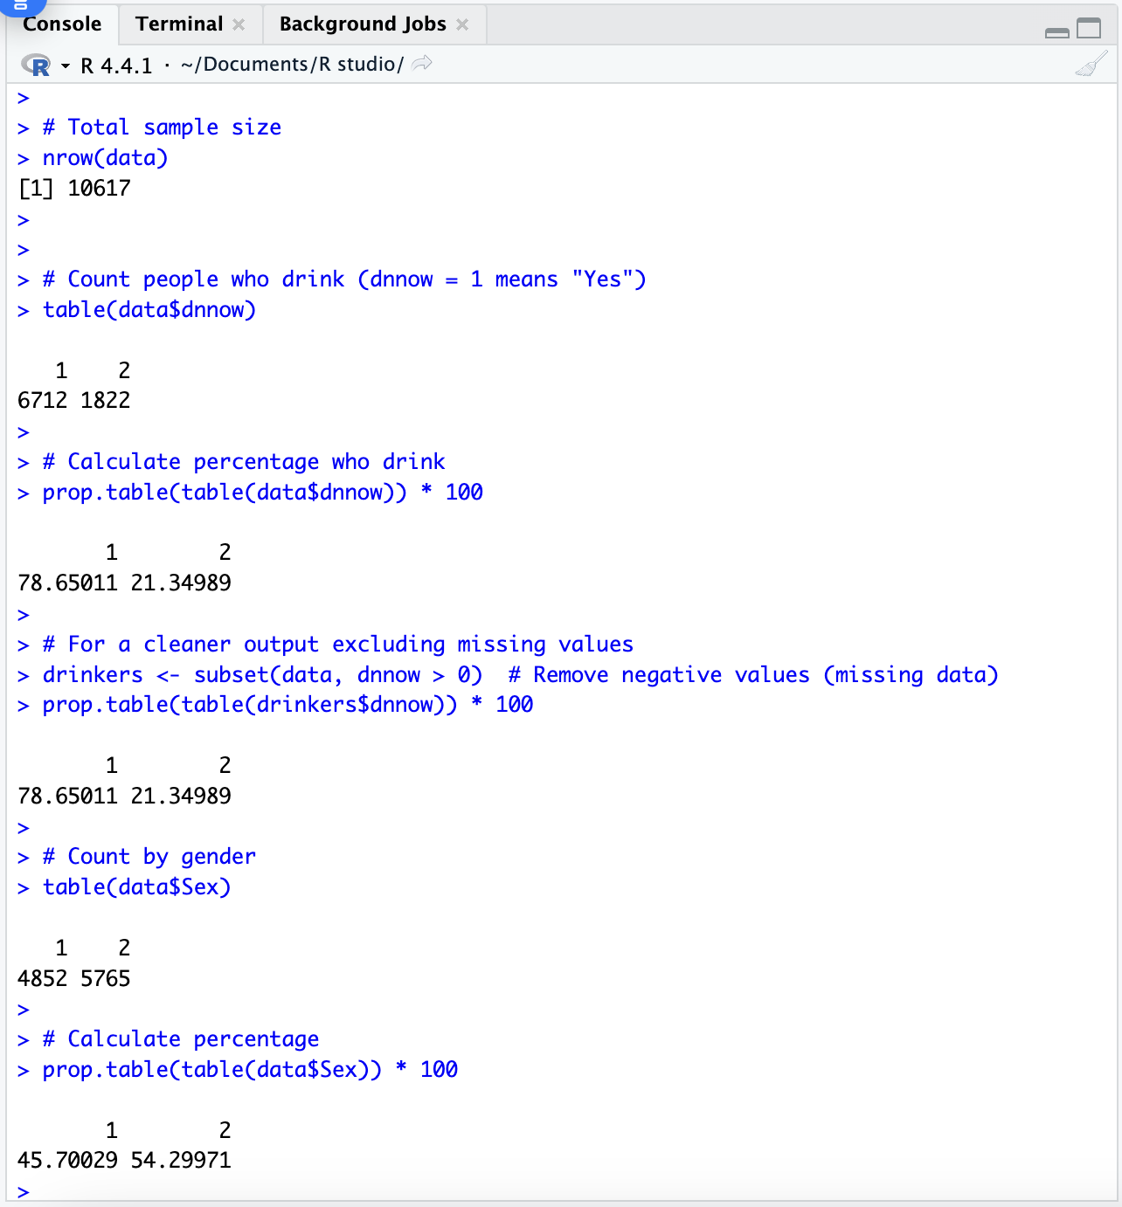
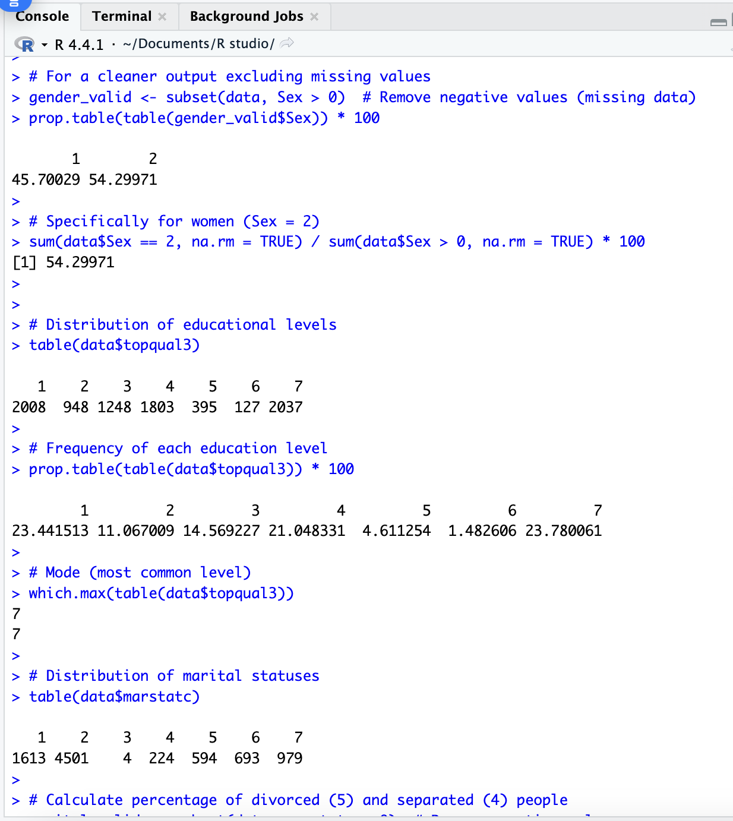
Appendix

Slide 24
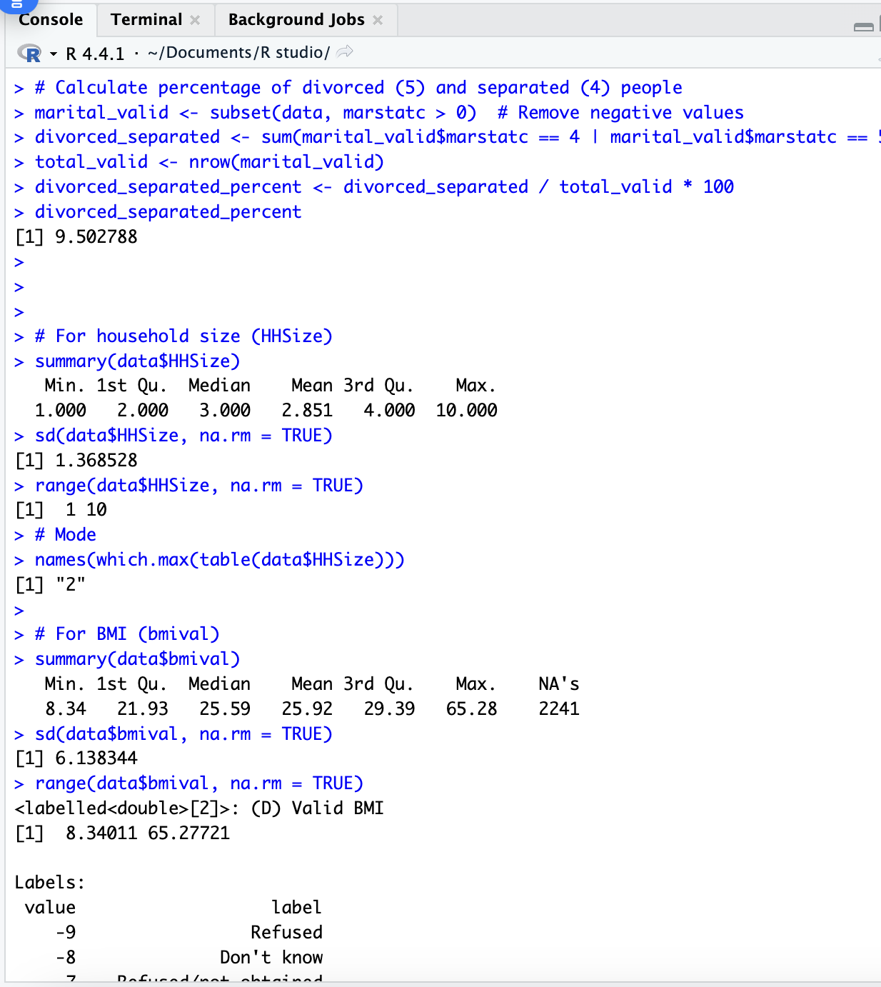
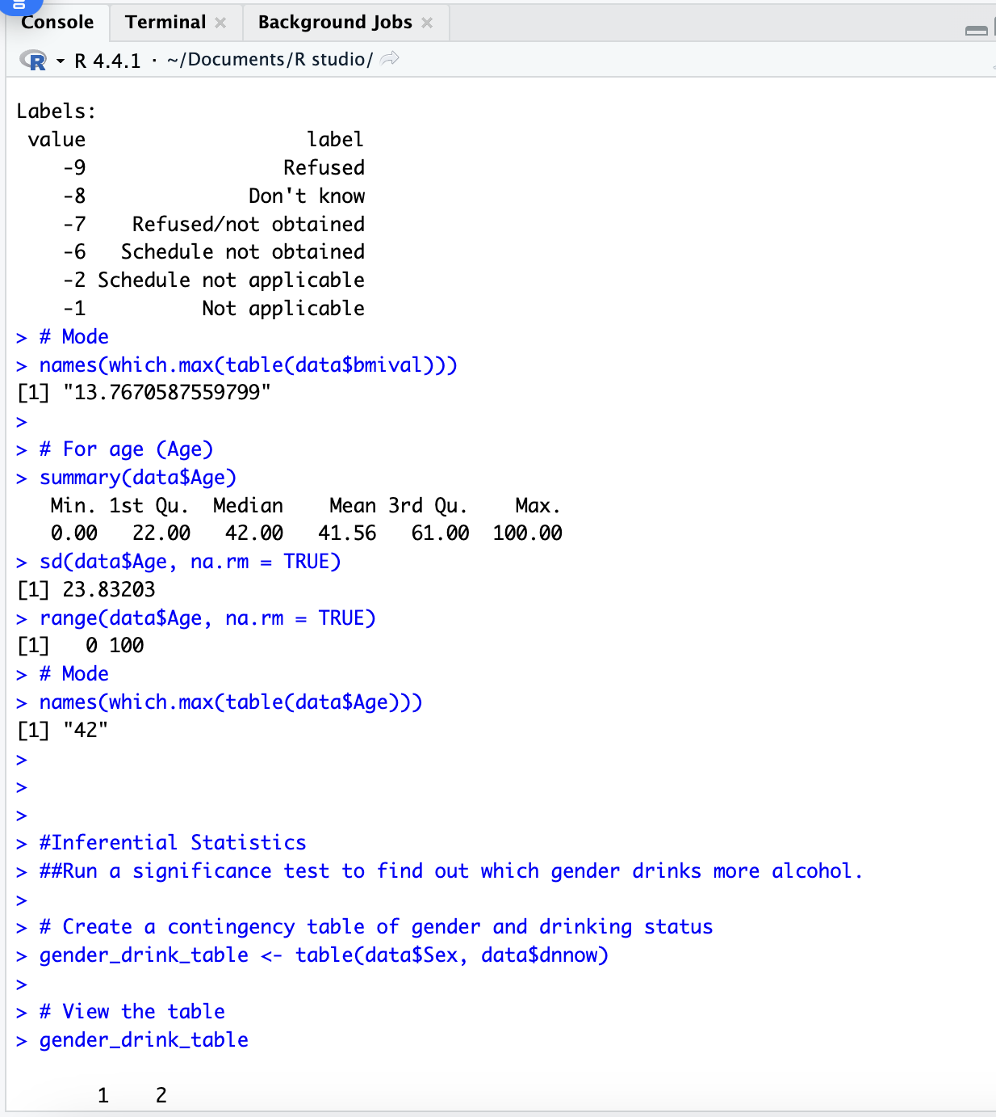
Appendix

Slide 25
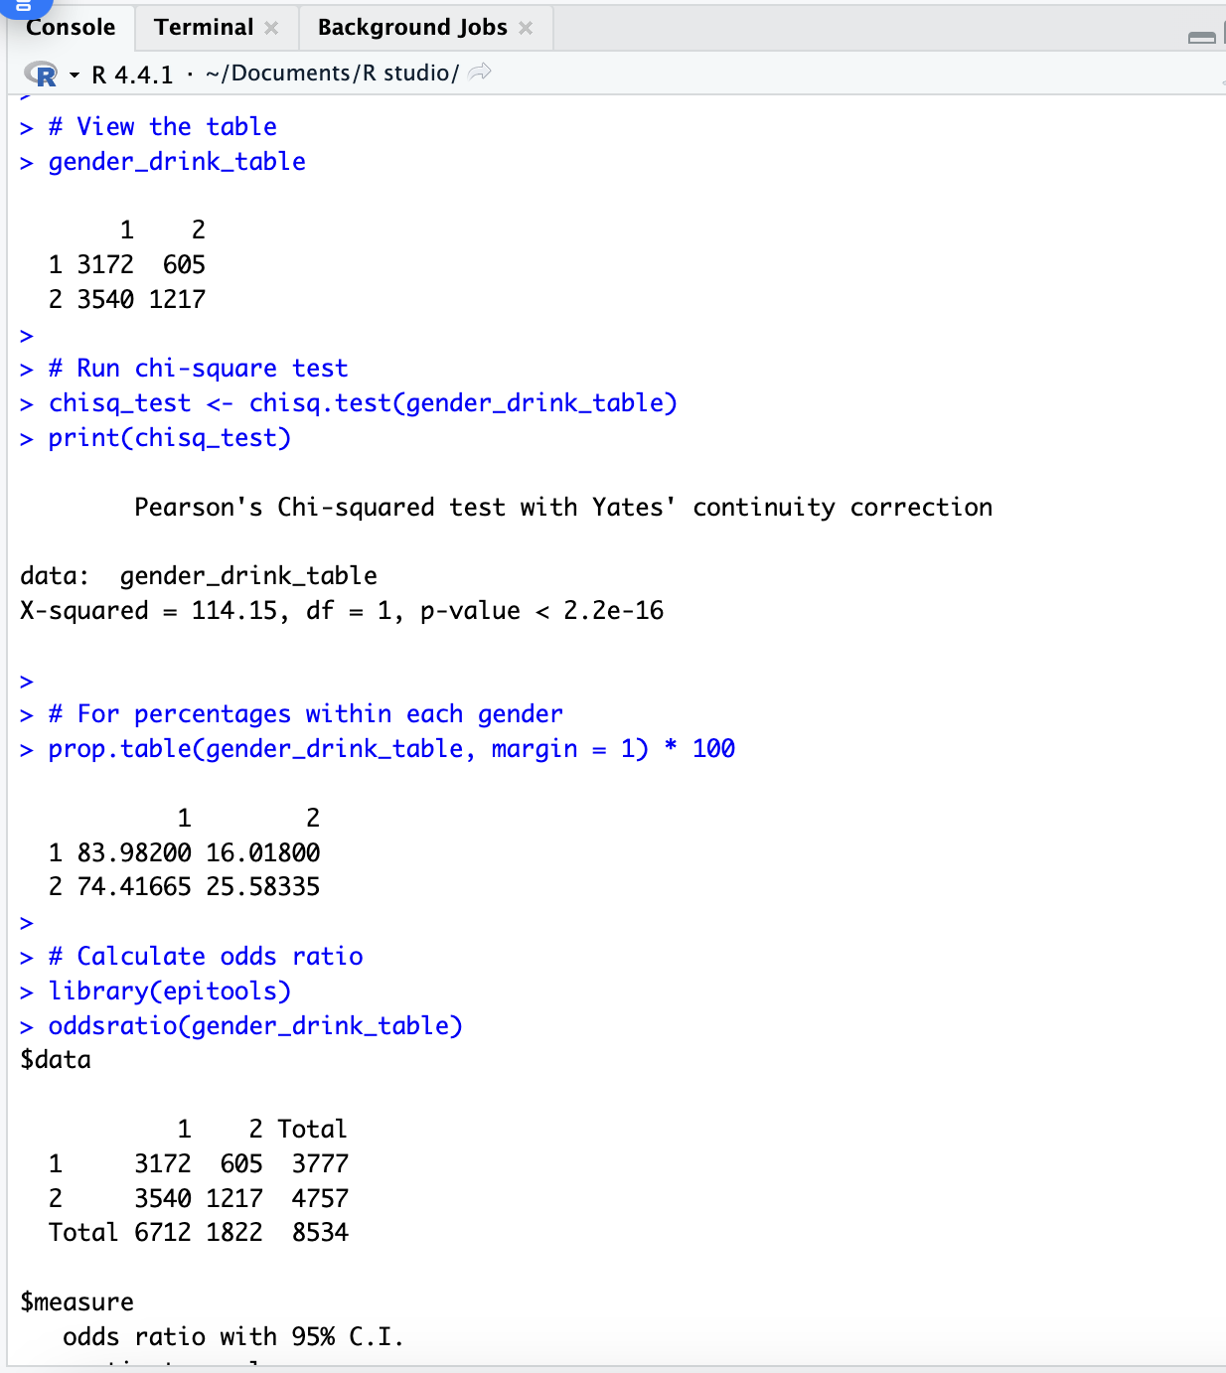
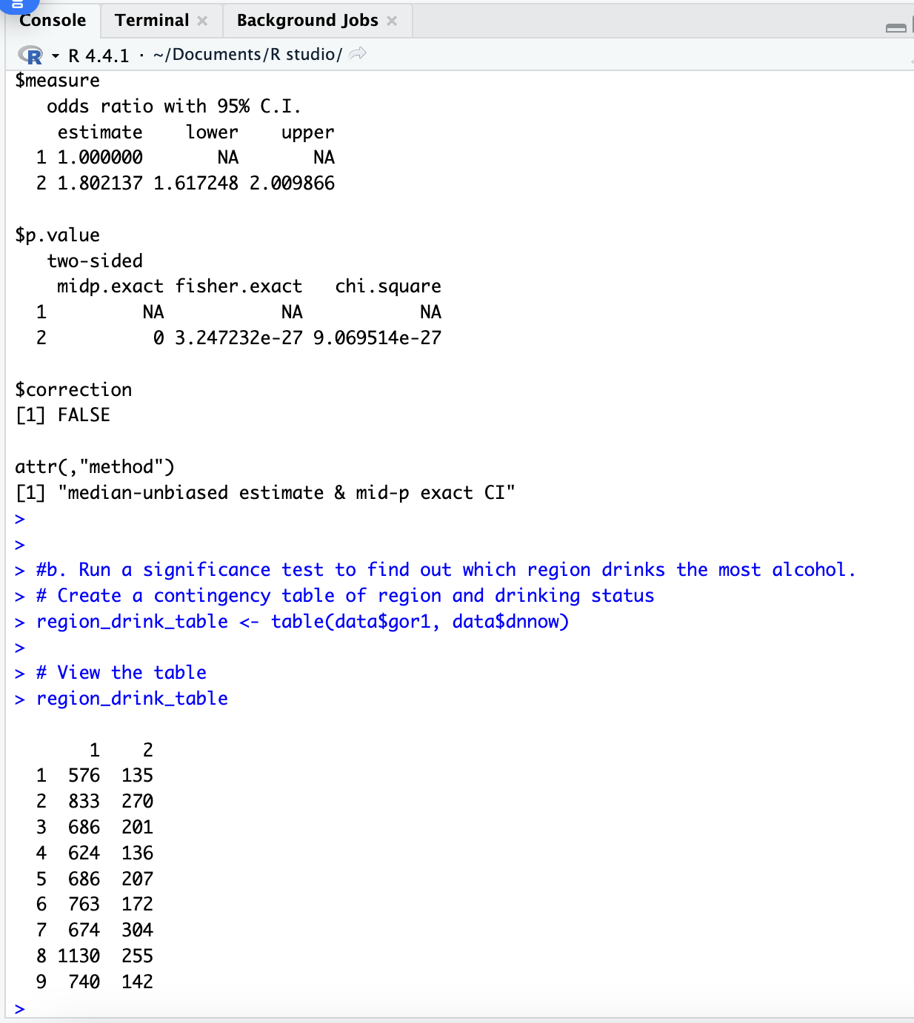
Appendix

Slide 26
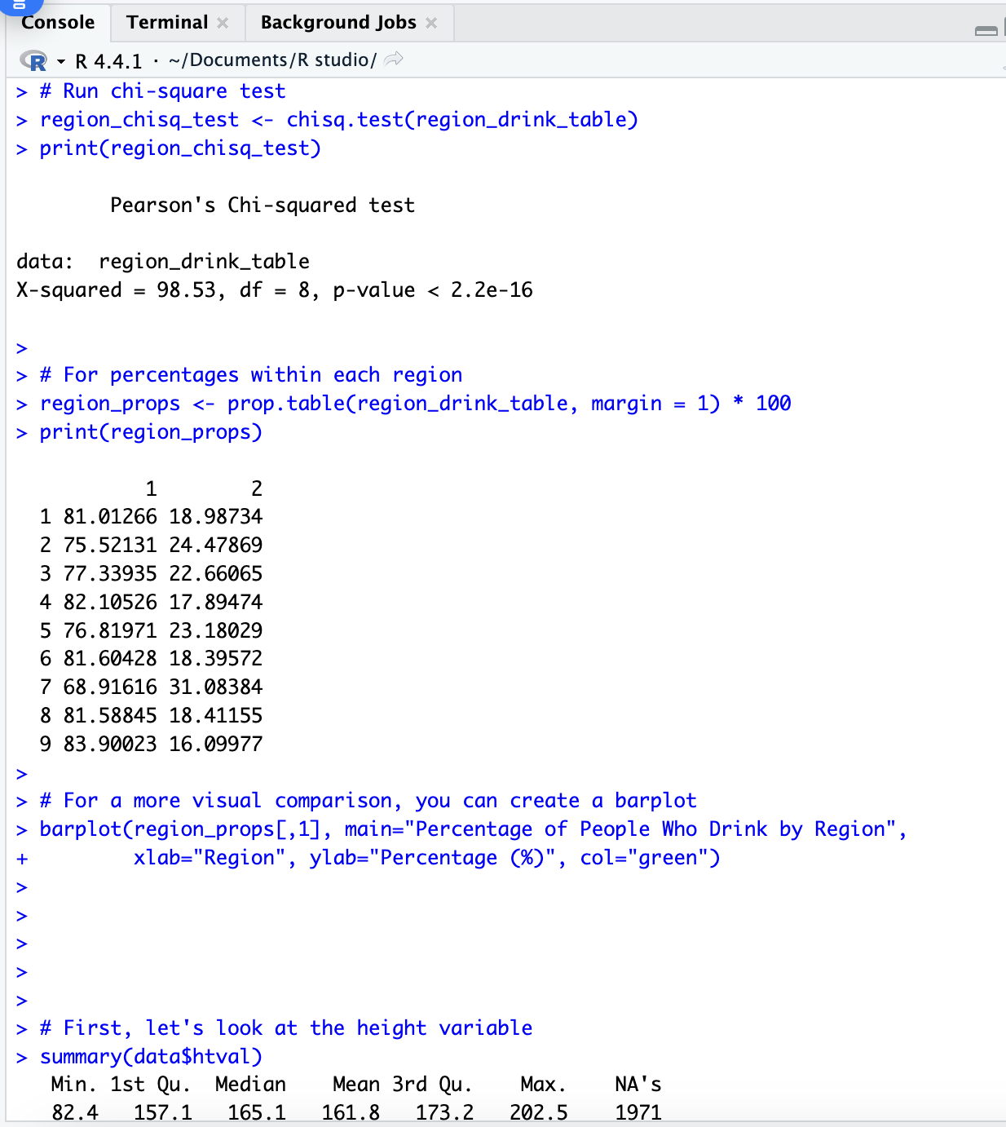
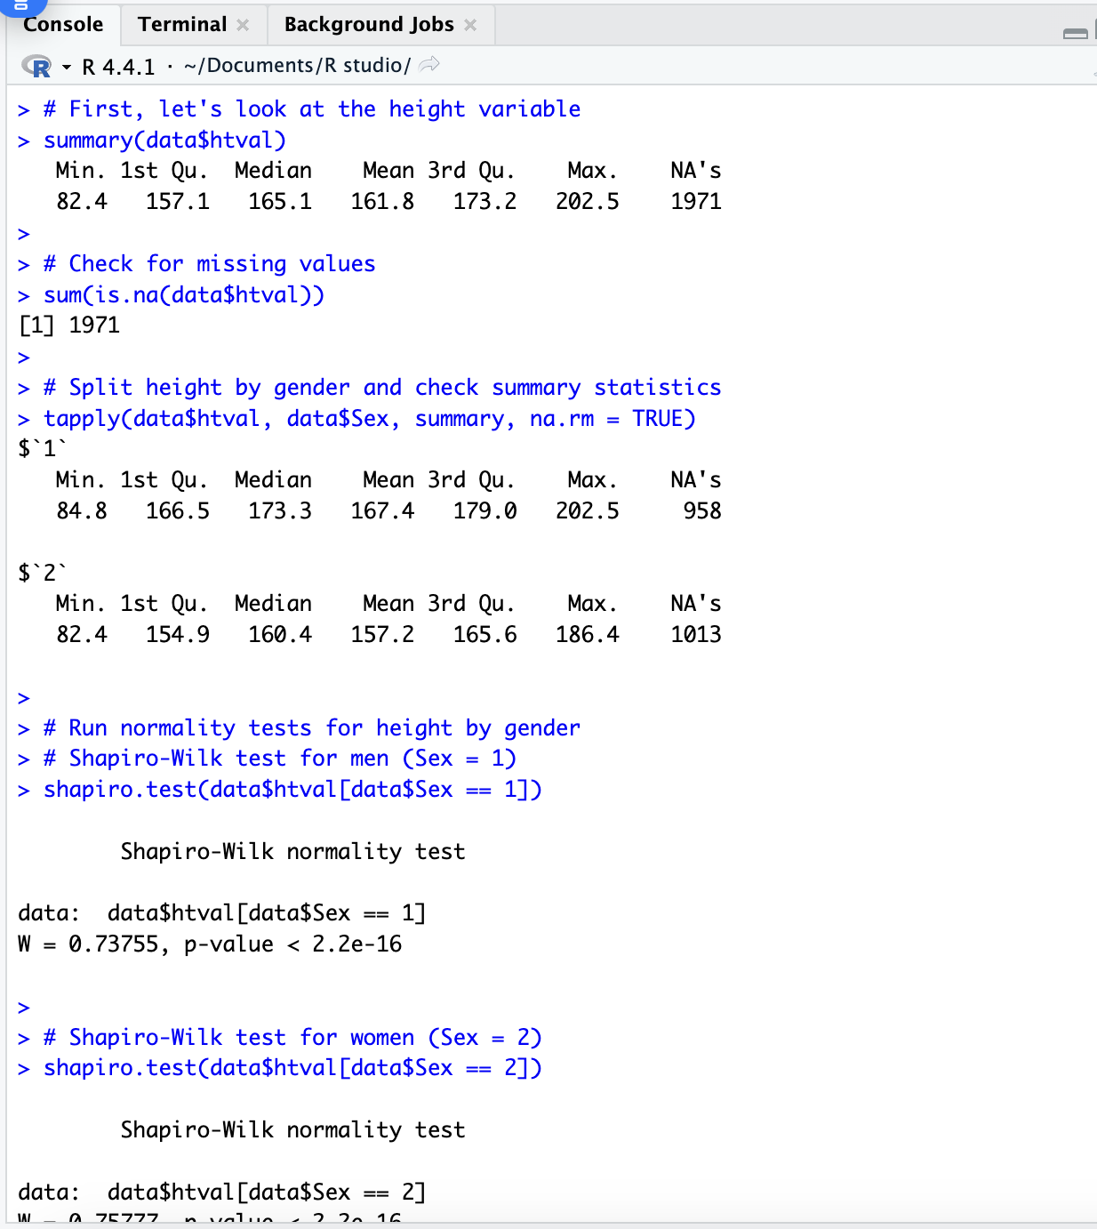
Appendix

Slide 27
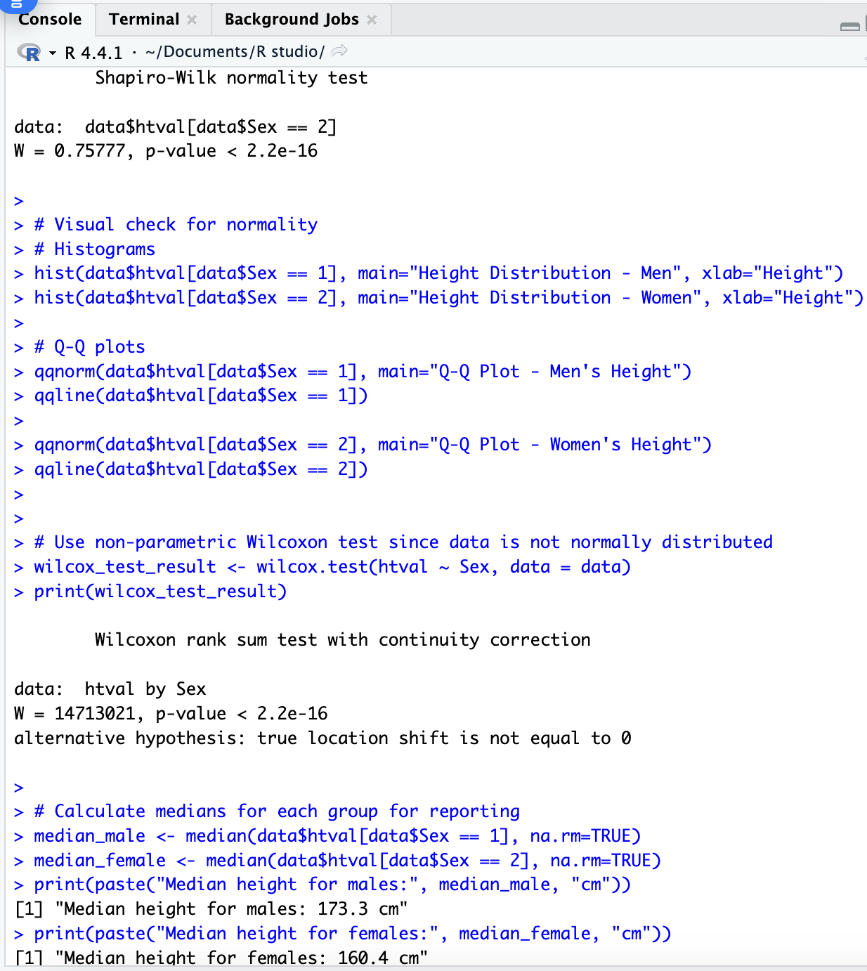
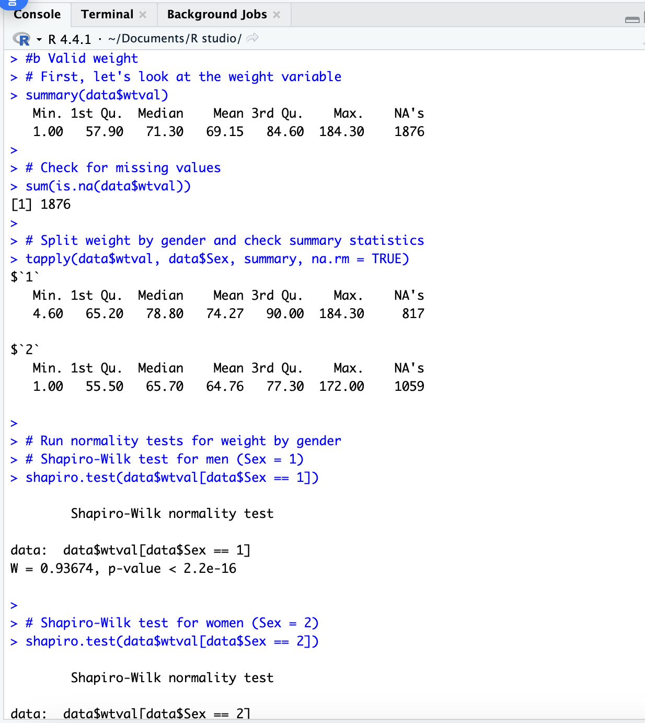
Appendix

Slide 28
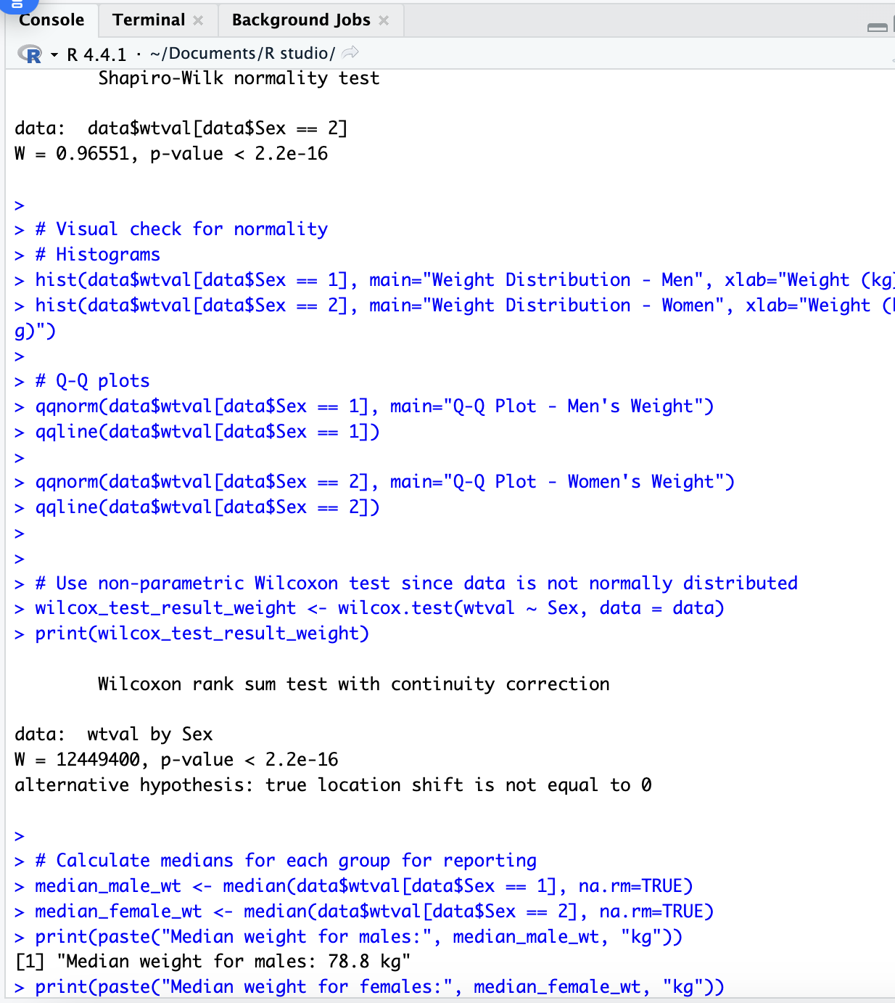
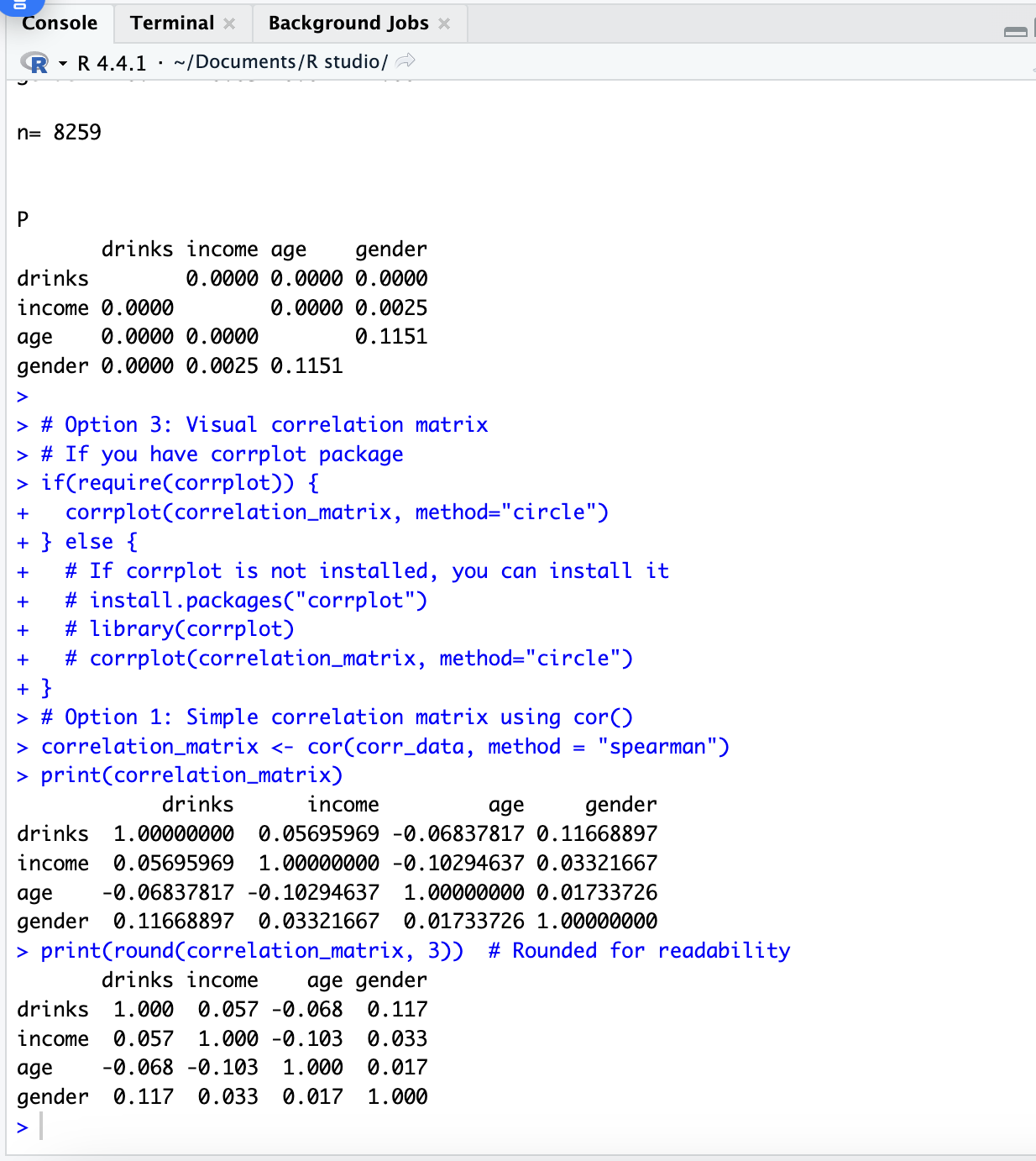
Appendix

